Slide 1
REACT
Lesson 4: Communication

Slide 2
Communication
Programming a complete CRUD
mockapi
Axios

Slide 3
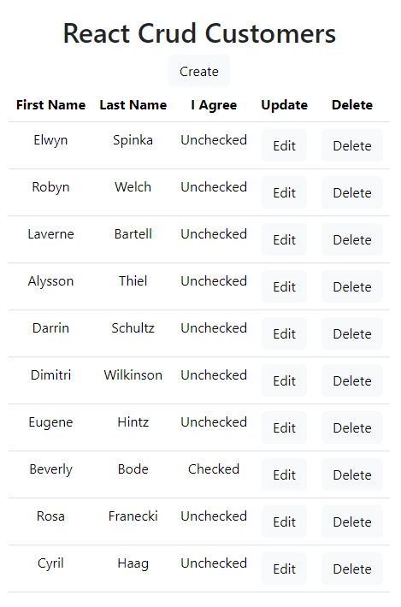
CRUD Customers
crud-customers

Slide 4
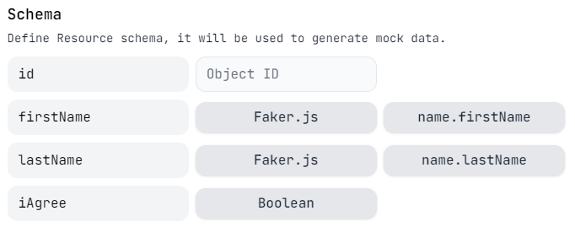
mockapi
Resource name: customers (10 customers)

Slide 5
config.json
Paste your API endpoint (customers resource at the end)
{
"mockapi": "https://6357d04548744236410271.mockapi.io/customers"
}

Slide 6
Axios
Axios is a promise-based HTTP client for JavaScript
Easy to send asynchronous HTTP request to REST apis and perform CRUD operations

Slide 7
mock_api.js
const baseUrl = configData.mockapi;
export default class MockApi { static get() {
return axios.get(baseUrl);
}
static getbyid(id) {
return axios.get(baseUrl + "/" + id);
} static post(customer) {
return axios.post(baseUrl, customer);
} static put(customer) {
return axios.put(baseUrl + "/" + customer.id, customer);
} static delete(id) {
return axios.delete(baseUrl + "/" + id);
} }

Slide 8
Sideeffects
A functional component renders output (based on props and state)
If a component contains instructions that don't target the output, these instructions are named side-effects: set a timer, fetch data from an api, ...
Redering should be decoupled from the side-effect!
Notes:
const getCustomers = async () => {
const result = await MockApi.get();
console.log(result);
}
getCustomers();

Slide 9
useEffect()
Welcome useEffect() — the hook that runs side-effects independently of rendering
useEffect(callback[, dependencies]);
callback is the function containing the side-effect logic. callback is executed right after changes were being pushed to DOM (after rendering the component)
dependencies is an optional array of dependencies. useEffect() executes callback only if the dependencies have changed between renderings
Notes:
useEffect(() => {
getCustomers();
});

Slide 10
Dependencies
useEffect(() => {
// runs after EVERY rendering
});
useEffect(() => {
// runs ONCE after initial rendering
}, []);
useEffect(() => {
// runs ONCE after initial rendering
// AND after every rendering ONLY IF "prop" or "state" changes
}, [prop, state]);

Slide 11
Complete the App

